Slide 1
Analysis of NBA Player's Shot Logs
Group leader: Ke Chen
Group members: Guanting Lu, Yueheng Han, Junfeng Li

Slide 2
Content:
1
Dataset introduction
2
Data mining and data visualization
3
Shooting result predication using ML algorithm
4
Challenges and conclusion

Slide 3
1
Dataset introduction

Slide 4
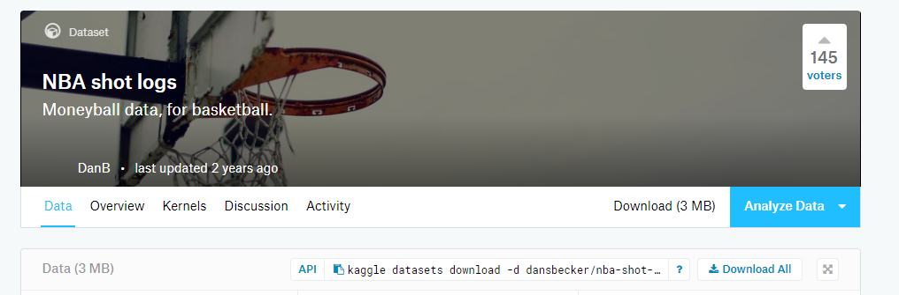
1. 2014-2015 season, 30 teams, 904 games, 281 players
2. About 130000 shot logs
3. 21 features including location(home or away), win or not, dribbles, touch time, defender distance,…

Slide 5
2
Data mining and data visualization

Slide 6
Some questions we want to ask:
1. What is the shot distribution in today’s league?
2. Does game location(home or away) really matter so much?
3. Who are Mr.Clutch(the one shooting the winning goal ) in 2014-2015 season?
4. NBA players’ field goal percentage of the season

Slide 7
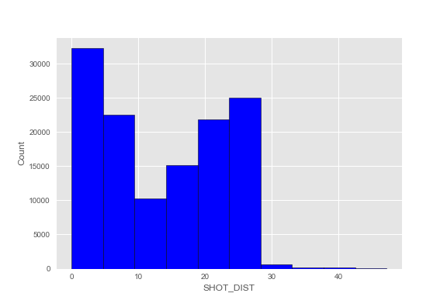
1. Shot distance distribution
Players prefer to knock down the three and slash to the hoop, layup or slam dunk.
They seldom throw short 2-points because
it is easy to be blocked and not efficient.

Slide 8
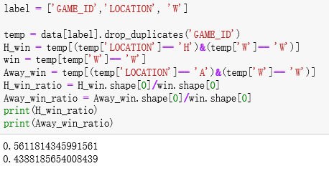
2. Does game location(home or away) really matter so much?
YES
The winning ratio at home is much more
than that away !

Slide 9
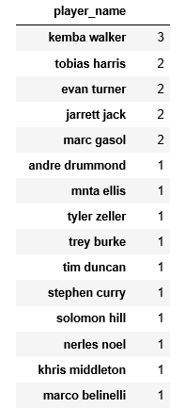
3. Who are Mr.Clutch(the one shooting the winning goal )
in 2014-2015 season?
Criterion of the winning goal:
They made it(2 or 3)
Less than five seconds from the end of the game
The team which Mr.Clutch belongs to won the game
This occurred in the 4th quarter
The final margin is less that 5 points.
According to the criterion we set, Mr.Clutch of the season are(top 15):
Kemba walker made it three times !

Slide 10
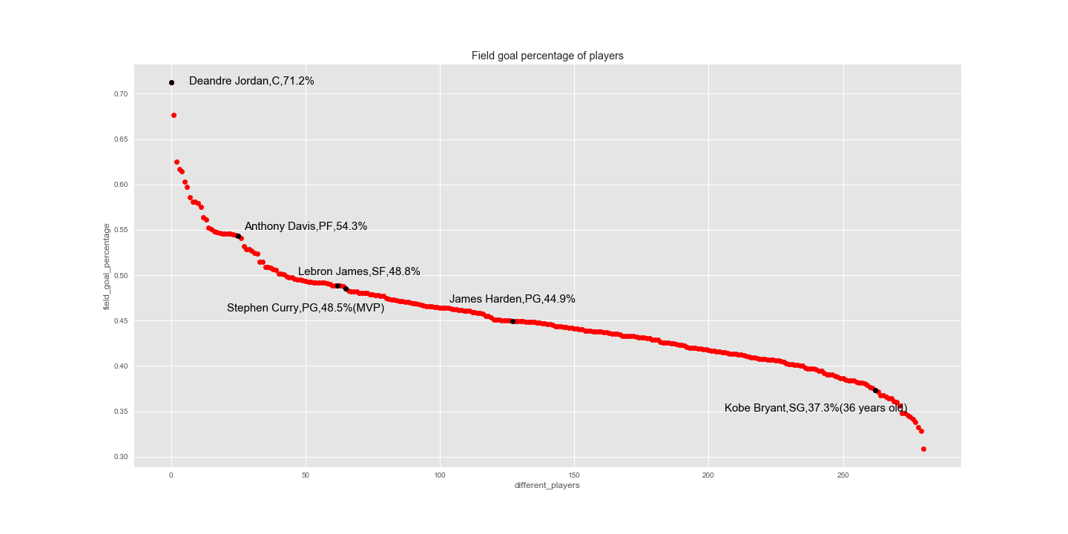
4. NBA players’ field goal percentage of the season

Slide 11
3
Shooting result prediction
using ML algorithm

Slide 12
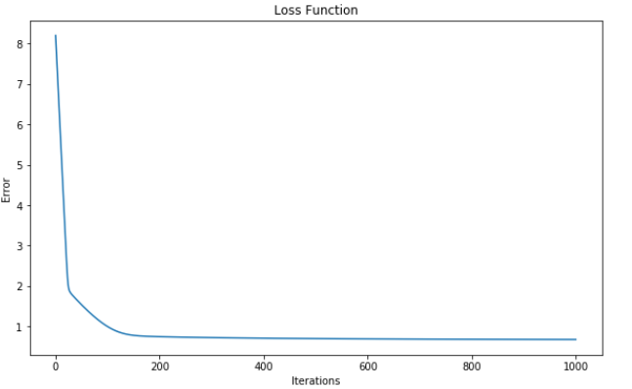
Logistic Regression
Features: Dribbles, Touch time, Shot distance
Samples: First 1000 shot logs
Accuracy: 58%
Will analyze why this low later

Slide 13
Neural Network
We add CLOSE_DEF_DIST to the previous features
Using all 128069 shot logs as samples
NN structure:
Input layer with 4 units
One hidden layer with 2 units and 7 units separately
Output layer with 1 unit
Result:
Cost didn’t decrease too much
Accuracy: 45%

Slide 14
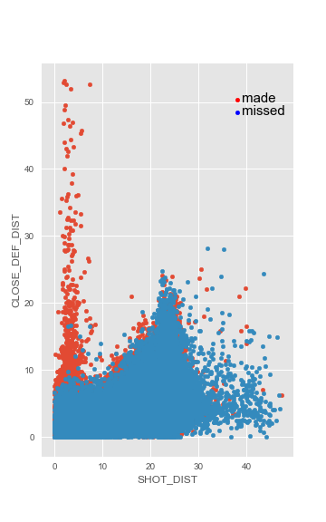
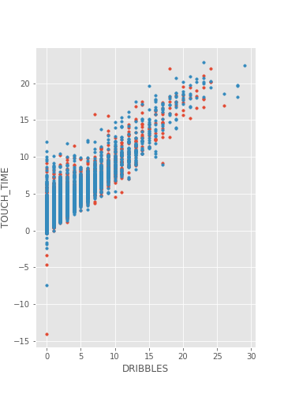
Result analysis
1.Do these features really matter the final result?
2. Structure development.
3. How about other programmers’ performances?

Slide 15
4
Challenges and Conclusion

Slide 16
Challenges
Unfamiliar functions
2. Debug

Slide 17
Conclusion
We answered some interesting questions by processing the dataset we chose.
For example, in today’s NBA league, players prefer to 3-point goals rather than short 2-points,
and the location of the game does have great impact on the result etc
2. We applied logistic regression and NN algorithm successfully to predict whether field goal
made or not, although the accuracy is not high because of the limitation of the dataset.
3. Frankly, there are many factors that could have an impact on a shot result besides the factors in
the dataset(dribbles, touch time, shot distance, etc), such as shot release velocity, jump height,
speed of shooter, angle to the basket etc. So perhaps we could do a better prediction with these data
in the future.

Slide 18
THANKS!

